Slide 1
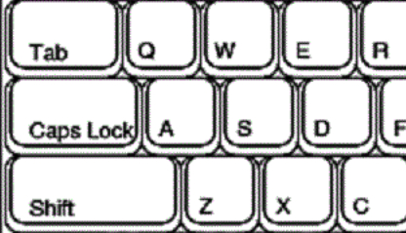
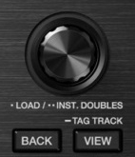
List Up
List Down
Seek --
Seek ++
Preview (hold)
Turn: Browser (while holding: seek Preview player
Load/Unload Preview player

